Slide 1
Lending Club case study
Submitted by: Prasad & Jitesh

Slide 2
Case Study Summary
Built understanding of the objective and different features in the
Addressed the data quality issues including missing values and outlier treatment
Univariate analysis of categorial and continuous variables
Derived new features from the data as per the domain understanding
Bivariate and segmented analysis with target and different features
Identified key metrics and patterns leading to Charge off

Slide 3
Data Cleaning and Manipulation
Dropped the features having less than 20% fill rate
Dropped the user behavior features which are not available before issuing the loan
Dropped the records with current loan status
Converted the data types of the features as per relevance
interest rate, loan term to float from object
Date fields to date from object
Created new columns with interest bins and funded_amnt_inv bins, and DTI bins.
Missing value imputations

Slide 4
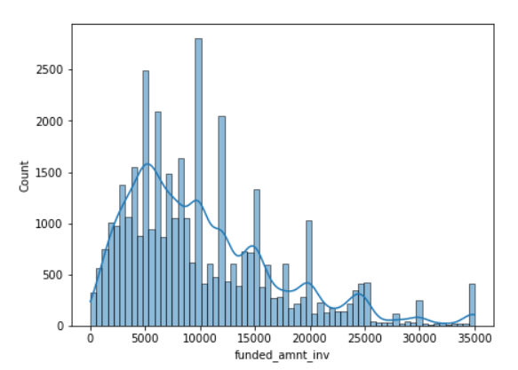
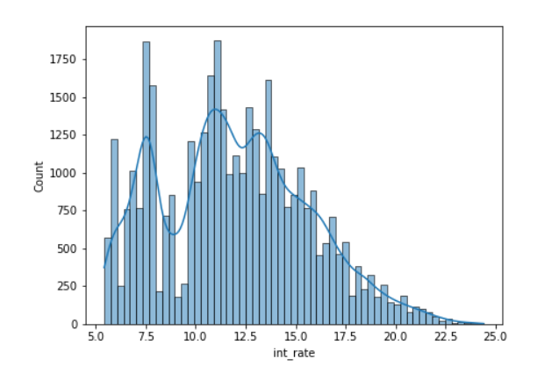
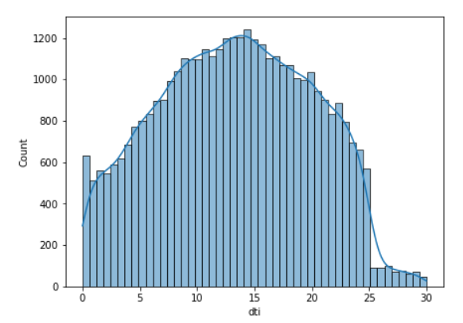
Univariate Analysis – Continuous Variables
Highest distribution of Issued amount lies is between 5000 to 15000.
Highest distribution of Installment amount lies between 200 to 500.
Highest distribution of interest rate lies between 10 to 15.
Highest distribution of DTI lies between 8 to 18.
A lot of features are quite skewed including annual income.

Slide 5
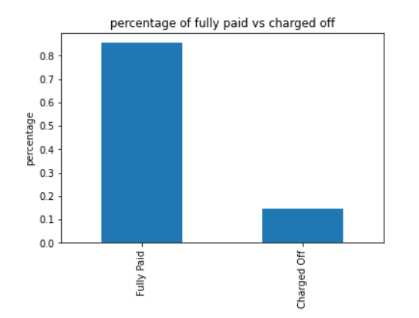
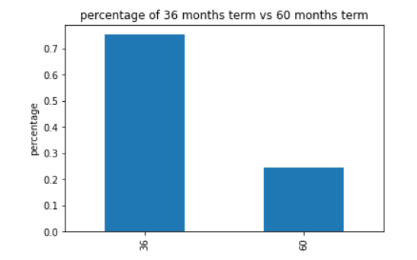
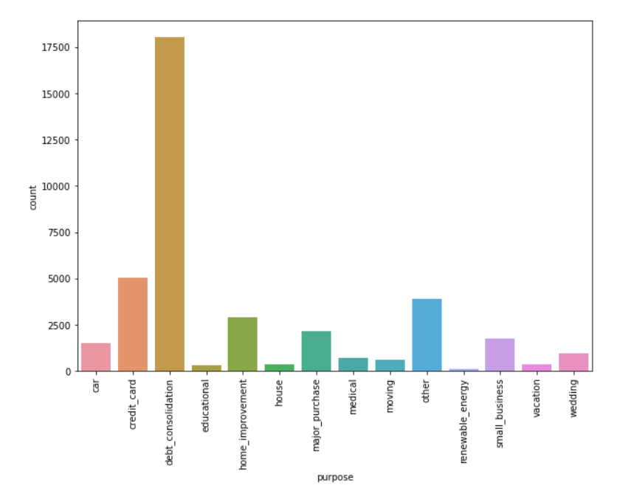
Univariate Analysis – Categorical Variables
There are around 15 percent charged off loans
76% of loans term is 36 months rest are 60 months.
Most number(~17500) of loans are taken for debt consolidation

Slide 6
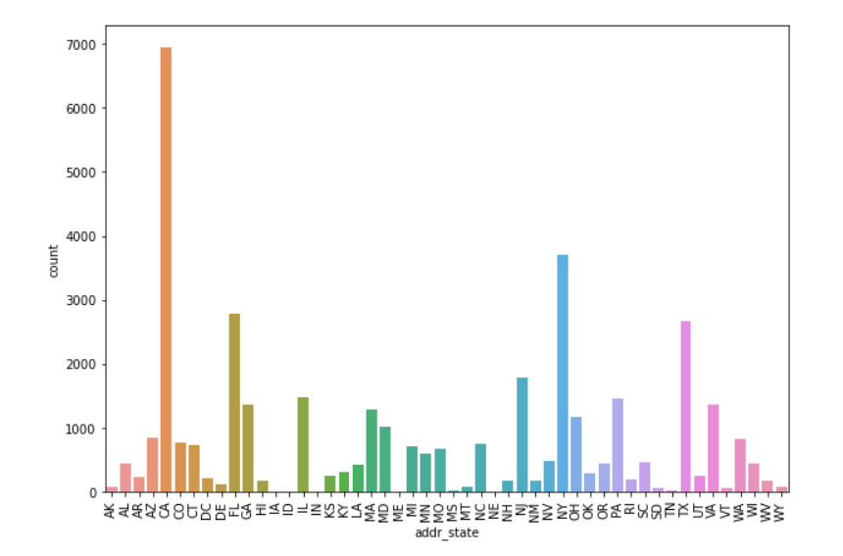
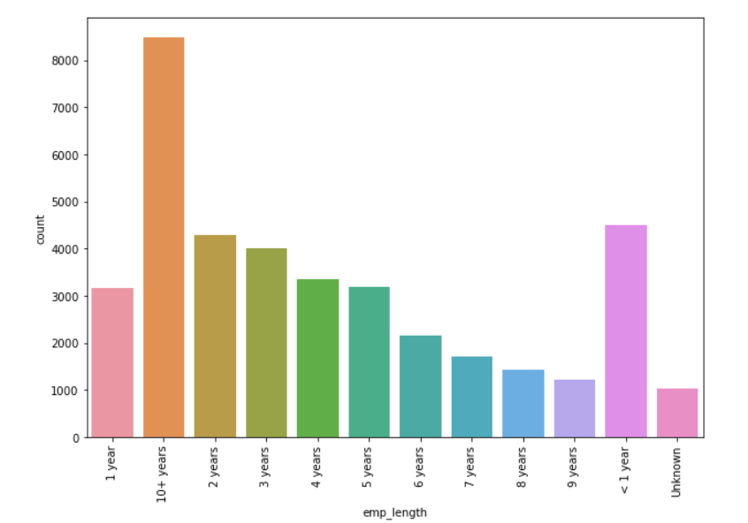
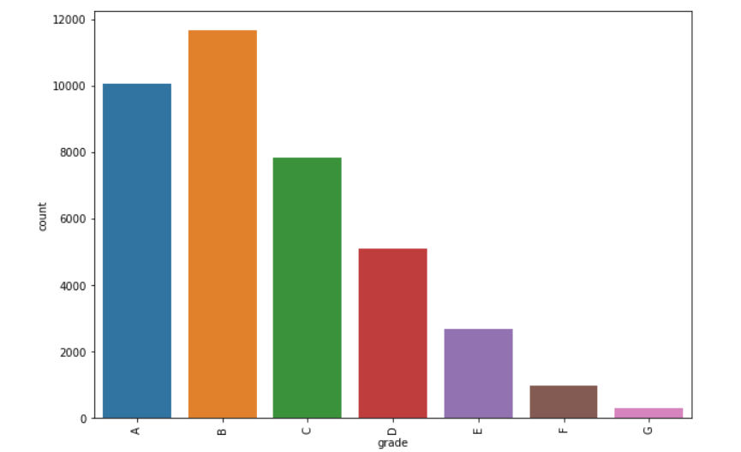
Univariate Analysis – Categorical Variables
States CA, NY, FL, Tx has highest number of loans.
Most number of loans are given to Grad A, B, C, D.
More number of loans are given to people with 10+ years, 1 year, 2 years experience respectively.

Slide 7
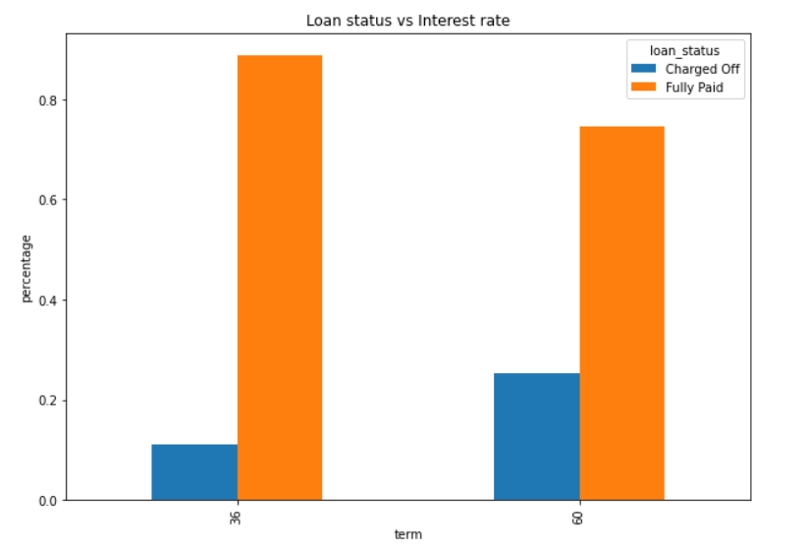
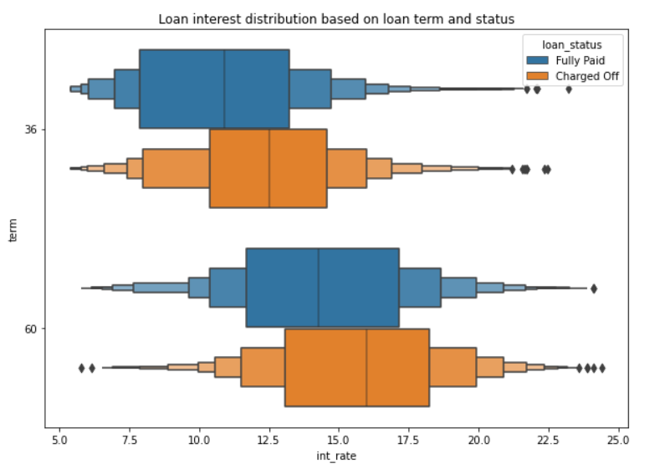
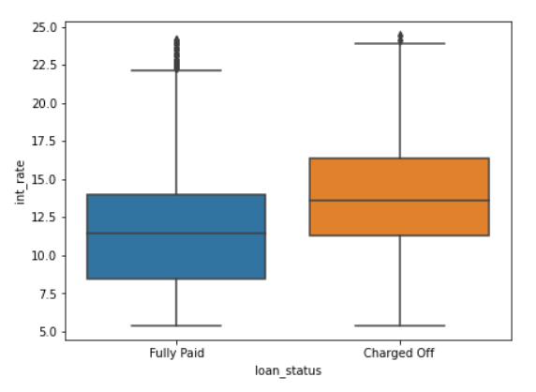
Bi-variate and Segmented analysis
If the loan term is 60 months, then there is more chance of being charged off.
Interest rate is also higher for 60 months compared to 36 months term.
On an average Charge off loans have higher rate of interest.

Slide 8
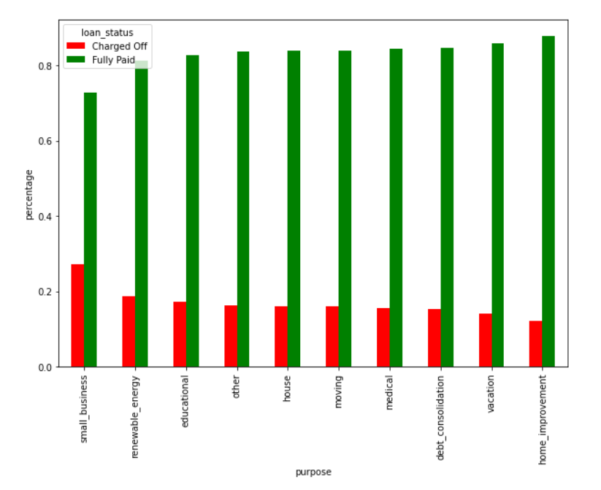
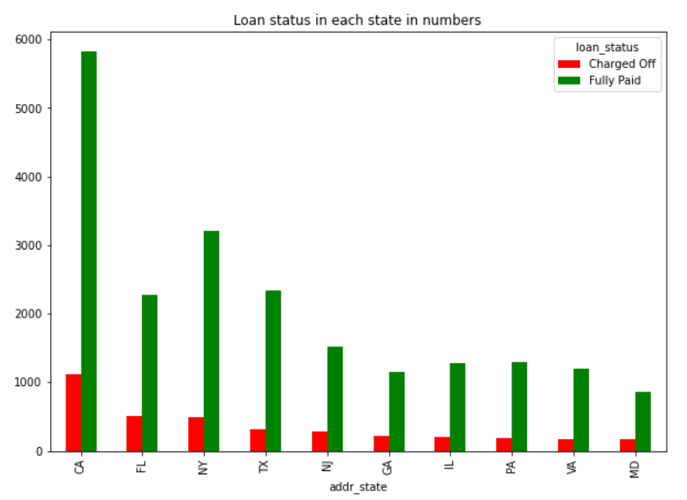
Bi-variate and Segmented analysis
Loans taken for Small business has a high percentage of charge offs.
NE State has the highest charged-off percentage(almost 60 percent).
CA State has a large number of charged-off loans.

Slide 9
Bi-variate and Segmented analysis
Grades E, F, and G have high-interest rates and percentages of charged-off loans.
If we look into subgrades F5 and G3 have more than 40 percent charged off loans.
If pub_rec_bankruptcies is high, then also there is more chance of being Charged off.
Charge-off percentage is slightly high(~2-4) for DTI range is between 15 to 27.
Charge-off is slightly high if the loan amount is greater than 30K.
Employment length “unknown” has a 20 percent of charged off loans.

Slide 10
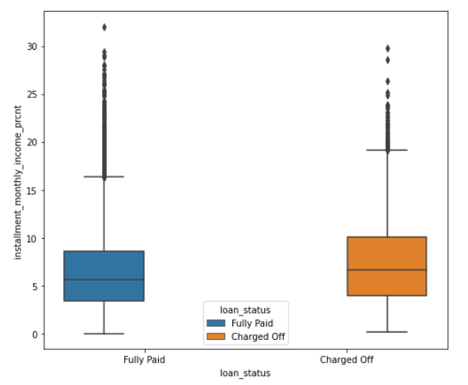
Feature Engineering
Calculating the difference amount of funded_amnt and funded_amnt_inv. Issuing more/less loan amount than approved amount doesn't have any effect on charged off.
Calculated the percentage of installment in monthly income. If the Installment to Monthly income percentage is more than ~8%, the chances of charge off increases

Slide 11
Conclusion
High interest is directly related to high charge off, can try reducing the interest rate
Should issue loans carefully for E,F,G grades which has higher charge off percentage
If the installment is over 8% of the monthly income, the chances of charge off are higher, can try keeping the installment percentage low
Should issue loans carefully to people from NE state as they have ~60% charge offs.
As people who took loan for small business has high chance of charge off, should be cautious while issuing loans to small business.
Should also reduce the number of loan for CA State as it has more number of charge offs.

